Slide 1
Python Operators
DVT101 – Lecture 5
- By Dataverse Tutorials

Slide 2
Introduction
What are Operators?
Why Operators are important
Operators in real-life logic
Role in Data Science & ML

Slide 3
Operators & Operands
Operator: Special symbol
Operand: Value or variable
Example: a + b
Understanding interaction

Slide 4
Types of Python Operators
Arithmetic
Comparison
Logical
Bitwise
Assignment
Identity
Membership
Ternary
Precedence & Associativity

Slide 5
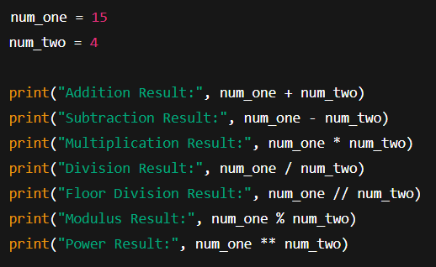
Arithmetic Operators – Concept
Used for mathematical operations
+, -, *, /, //, %, **
Python 3 division behavior

Slide 6
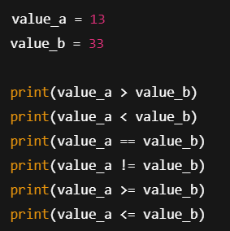
Comparison Operators – Concept
Compare two values
Output: True or False
Used in conditions

Slide 7
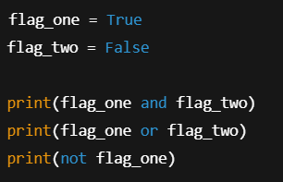
Logical Operators – Concept
and
or
not
Combine conditions

Slide 8
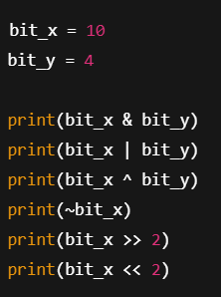
Bitwise Operators – Concept
Works on binary level
Used in low-level optimization
Advanced topic

Slide 9
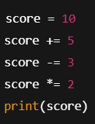
Assignment Operators – Concept
Update variable values
Shorter syntax
Clean code

Slide 10
Identity Operators
is
is not
Memory comparison

Slide 11
Membership Operators
in
not in
Sequence check

Slide 12
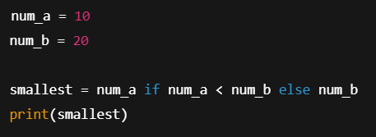
Ternary Operator – Concept
One-line condition
Clean alternative to if-else

Slide 13
Precedence – Concept
Order of execution
Avoid logical bugs

Slide 14
Associatively – Concept
Same precedence handling
Left to right / Right to left

Slide 15
Summary & Key Takeaways
Operators are core of Python
Used everywhere in Data Science
Strong foundation is mandatory

Slide 16


